Slide 1



Slide 2
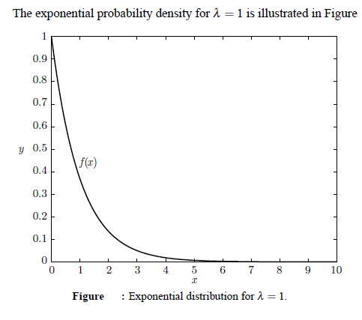

Slide 3
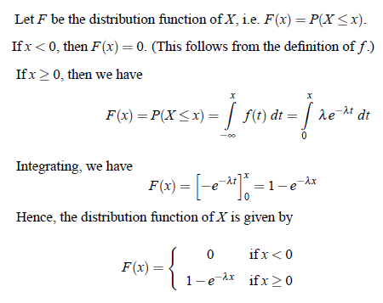
CUMULATIVE DISTRIBUTION FUNCTION/DISTRIBUTION FUNCTION

Slide 4
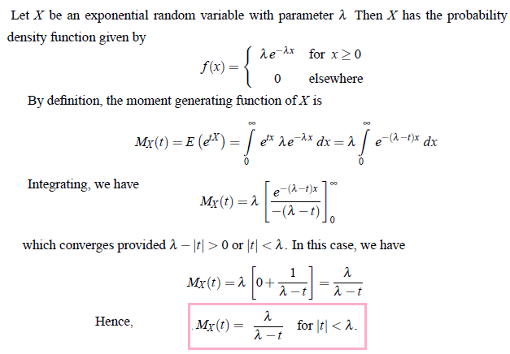
M.G.F, MEAN & VARIANCE OF EXPONENTIAL DISTRIBUTION

Slide 5
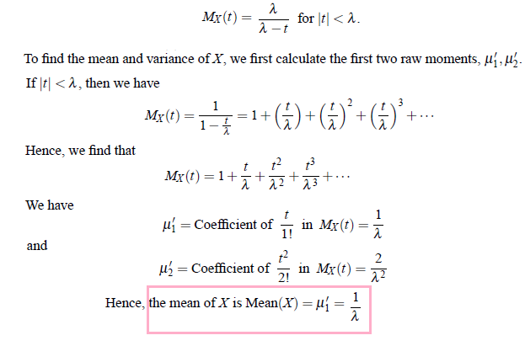

Slide 6
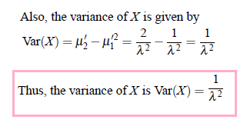

Slide 7

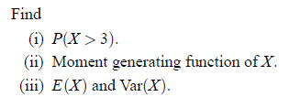

Problem : 1

Slide 8
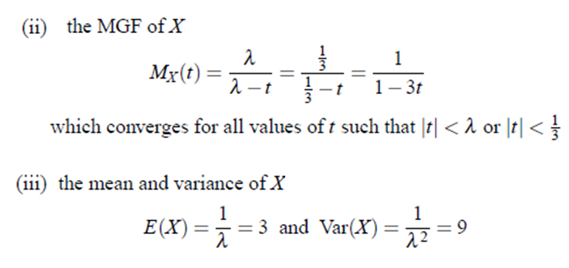

Slide 9

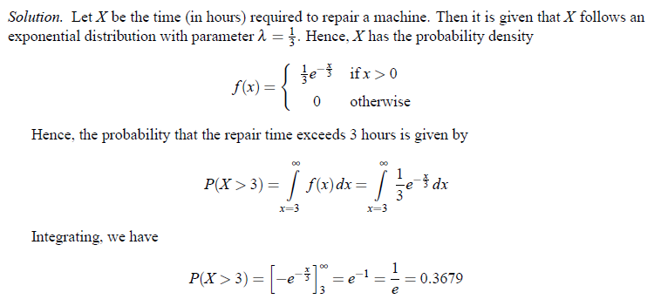
Problem : 2

Slide 10

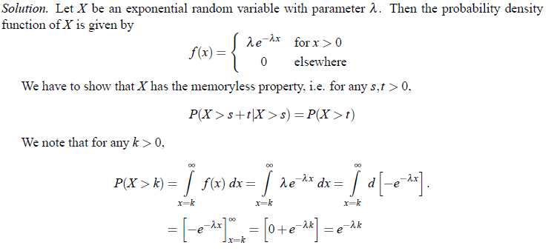
Problem : 3

Slide 11



Slide 12



Problem : 4

Slide 13


Problem : 5

Slide 14

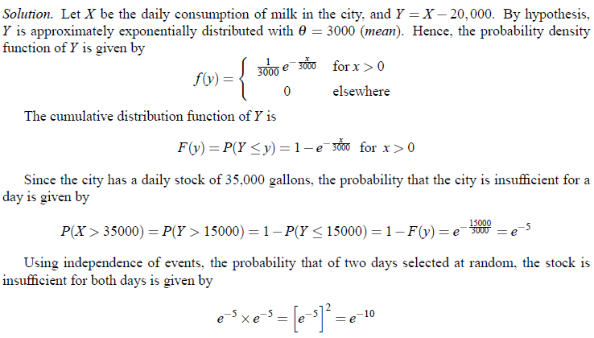
Problem : 6

Slide 15
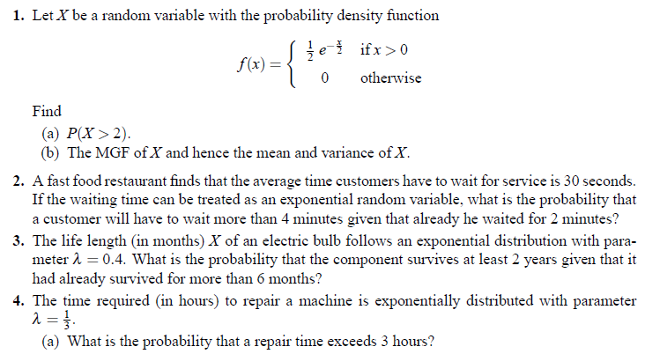
Problems for Practice

